Slide 1
Capstone
Package management
Connecting to APIs
Testing programs with API calls

Slide 2
Package Managers
Package managers are responsible for:
Installing, managing, (and removing) the correct version of 3rd party packages/libraries that are required by your program
Contacting an online repository to obtain packages
Putting them in the right place in your project, for your code to access
Examples:
Java: Maven and Gradle; code repositories at Maven Central etc.
RubyGems; rubygems.org
npm for Node/JavaScript; npmjs.org
NuGet for .NET; nugetgallery.org
pip and PyPI, Python Package Index, pypi.python.org/pypi
Comparisons of various languages' package managers: http://blog.versioneye.com/2014/01/15/which-programming-language-has-the-best-package-manager/

Slide 3
Python Packaging
http://www.ewencp.org/blog/a-brief-introduction-to-packaging-python/

Slide 4
Definitions
PyPI: Python Package Index, a repository of Python packages https://pypi.python.org/pypi
pip is Python's package installer tool (may have the alias as pip3 on your machine)
Virtual environments helpful to manage different dependencies (and different versions of the Python interpreter) needed for different Python projects
setup.py When distributing your project, need some way to describe your project and its dependencies.
Create a setup.py file contains information about your package and instructions on which dependencies should be fetched and installed
A packaging tool (like setuptools); reads setup.py when your package is downloaded and installed; dependencies are fetched and installed
requirements.txt a list of dependencies. Used instead of/as well as setup.py; usually during development (setup.py more common for production and distribution)

Slide 5
Installing and removing packages with pip
Search for package
pip search <packagename or partial package name>
Installing - for all users, or for just this user
Lab computers, use the --user version
pip install <packagename>
pip install --user <packagename>

Slide 6
Installing and removing packages with pip
updating a package
pip install --upgrade <packagename>
removing
pip uninstall <packagename>

Slide 7
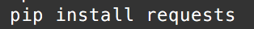
pip connects to PyPI
pip locates, downloads, and installs the package requested
By default, the package is available to all Python projects on your computer

Slide 8
Couple of questions..
What if one project depends on version 1.4 of a package, but another project depends on version 2.6 of the same library?
For example, you are developing a new project with the latest version, but are also maintaining an old project, using an earlier version of the same library?
When you want to distribute your project, how will you include the correct versions of your dependencies?
Which versions of libraries have you installed?

Slide 9
Solution: virtual environments
Create a virtual environment and install this project's dependencies in it
Create an isolated environment for this project
Other projects can have their own virtual environments, with their own dependencies

Slide 10
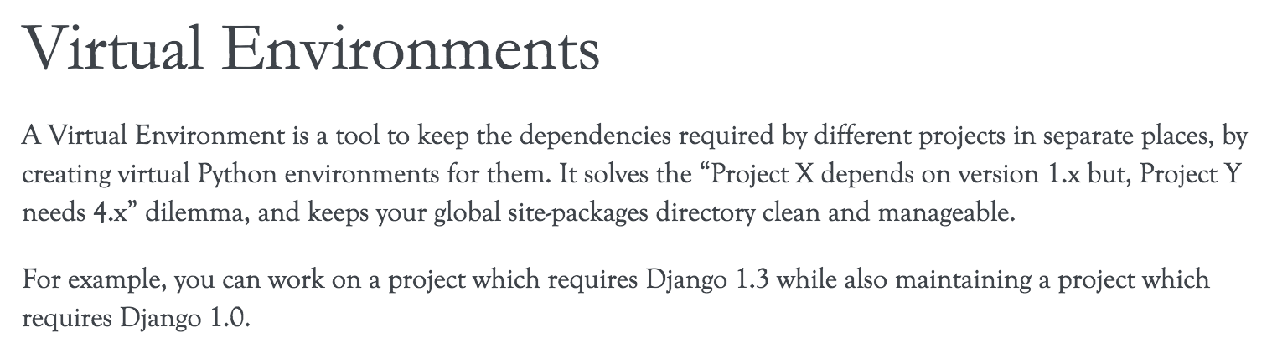
Virtual Environments
From the Hitchhikers Guide to Python
http://docs.python-guide.org/en/latest/dev/virtualenvs/

Slide 11
Virtual Environments
Create an isolated Python environment with its own packages, and own versions of packages installed
Can select the Python interpreter version for each virtual environment - Python 2 or Python 3?
When using pip in a virtual environment, the packages installed (and uninstalled) will be unique to that virtual environment
Makes development more organized
Various other tools available to manage virtual environments
http://docs.python-guide.org/en/latest/dev/virtualenvs/

Slide 12
Per project: create and activate a Virtual Environment
From the command line,
(For a new project) create a directory for your project if it doesn't yet exist
Navigate to that directory
Type the commands for your own OS
python3 -m venv env
source env/bin/activate
Mac or Linux
python -m venv env
env\scripts\activate
Windows PC

Slide 13
Installing packages into a virtual environment
From an activated virtual environment,
typing
pip install <whatever>
only installs <whatever> for this virtual environment
deactivate
returns to the default install of Python+standard libraries and whatever global packages are installed

Slide 14
Virtual Environments
Each computer will set up it's own virtual environment
Create a new virtual environment for any non-trivial project that has dependencies
Keeping each one of your projects in an individual directory helps manage your virtual environments

Slide 15
requirements.txt and pip freeze
Type
pip freeze
to see a list of dependencies and versions
Type
pip freeze >> requirements.txt
to copy these dependencies into requirements.txt file
When someone else runs your project, they can install all of the requirements, listed in this file; the specified version of each will be installed
pip install -r requirements.txt

Slide 16
Deactivating a virtual environment
Deactivate your virtual environment when done with the project by running deactivate
And before you start, or work on a project, with a different virtual environment
deactivate
You can reactivate an existing virtual environment with
source env/bin/activate (mac)
env\Scripts\activate (pc)

Slide 17
APIs

Slide 18
How do different computer systems talk to each other?
Scenario to consider:
An e-commerce retailer. Which systems may work together to display products (with reviews, similar product suggestions) on pages, take orders, process orders, ship orders... ?
Typical IT infrastructure has many separate systems that communicate as needed

Slide 19
Many ways to connect systems
Message Passing https://en.wikipedia.org/wiki/Message_passing
CORBA - turning objects from one programing language into objects in another programming language
PubSub https://en.wikipedia.org/wiki/Publish%E2%80%93subscribe_pattern
But one of the most common is via HTTP - RESTful APIs

Slide 20
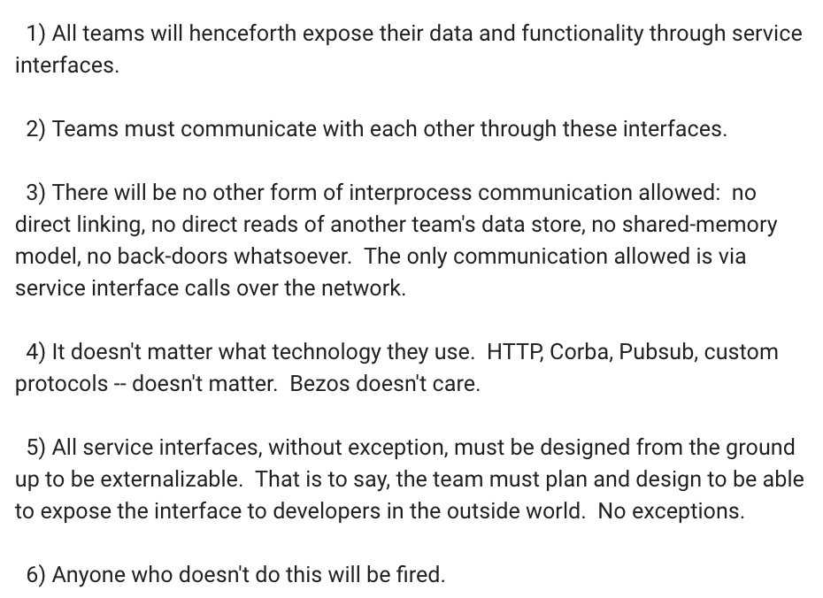
Amazon
Mandate from Jeff Bezoz, circa 2002
Required all the internal systems to communicate and externalize data via services
In other words, everything has a structured way to communicate with other services
How's Amazon doing today?
https://plus.google.com/+RipRowan/posts/eVeouesvaVX

Slide 21
HTTP
HTTP is the protocol used for browsers to request web pages, and for servers to send pages, images, other resources in response
Can also use HTTP to send requests from your program to another computer, somewhere else on the network (or internet)
The other computer can respond with data of some kind - a file, text, error message, or JSON
See Mini topics > JSON in D2L for background on JSON

Slide 22
HTTP Requests with requests
Python has built-in libraries for making HTTP requests but it's a little clunky to use
So we'll use the requests library instead which is really nice
Create a virtual environment, activate it, and install requests with
pip install requests
http://docs.python-requests.org/en/master/
See installing peewee slide from databases for correct version of the pip command for your computer

Slide 23
First HTTP request
We need a random cat fact
So we need a random cat fact service
Let's use the https://catfact.ninja API

Slide 24
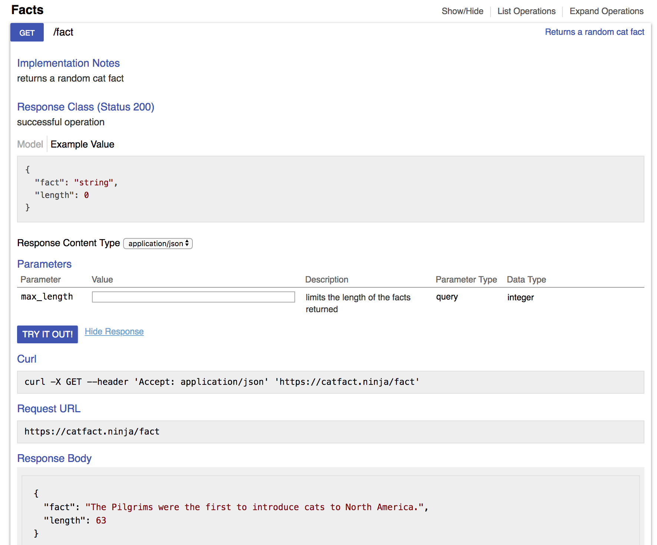
Using an API
Step 1: read the documentation to figure out what request to make
There's an example URL
Paste it into your browser address bar to see what happens

Slide 25
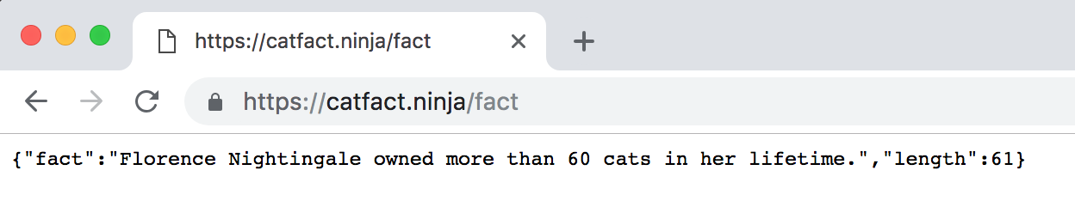
Step 2: Test out the API
Test in browser or with curl
Looks like a random cat fact
What format is the data in?
JSON response - plain text but formatted to be readable by computers. Looks like a Python dictionary

Slide 26
Step 3: How is the response structured?
Note the JSON has keys "fact" and "length".
We are interested in the fact

Slide 27
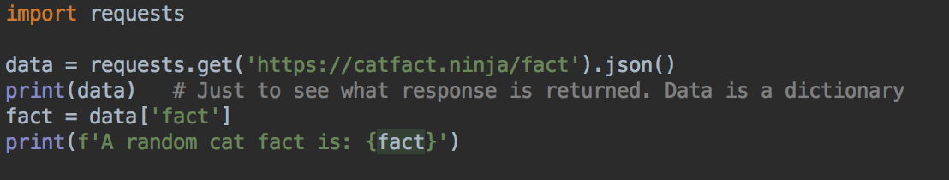
Step 4: Use in program
Import requests
Make request
Parse response into JSON, which is provided to your program as a dictionary
Use response in program

Slide 28
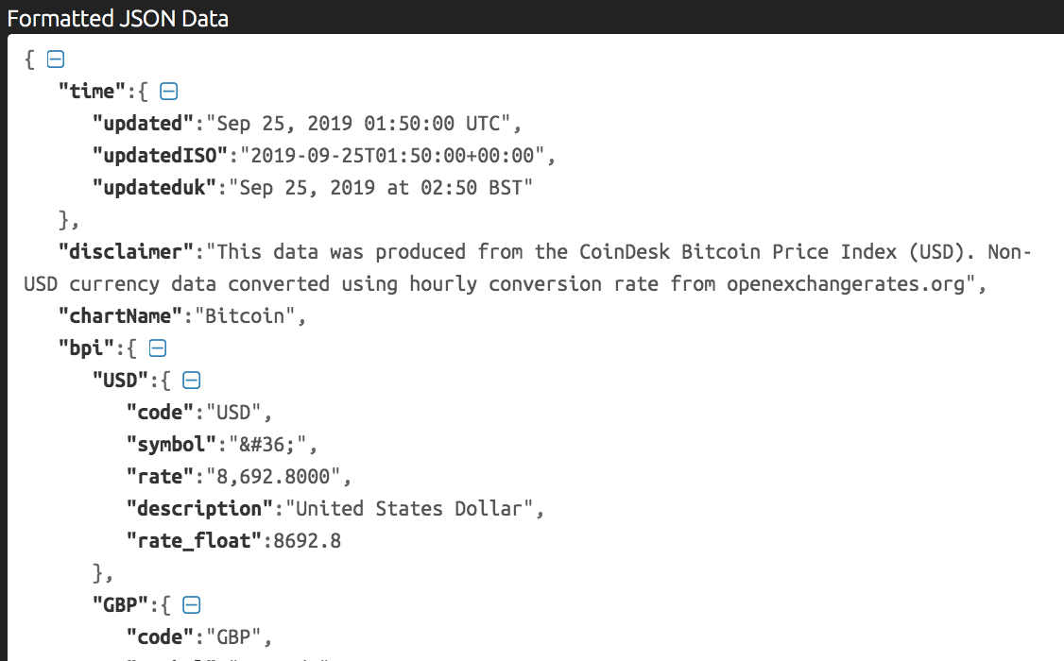
Your Turn: Bitcoin Price API
Write another program to get the current Bitcoin price using an API like https://www.coindesk.com/api
The user should be able to enter a number of Bitcoin. Your program will calculate and display their value in USD
A JSON formatter, for example, https://jsonformatter.curiousconcept.com/ is helpful to make sense of the response
You need this rate value

Slide 29
API Keys
These APIs are unusual because you don't have to authenticate to use the service
Most APIs are restricted to authorized users
Why?
Either with OAuth - equivalent of a username and password
Or require a key to access - less security but still useful for managing and monitoring users

Slide 30
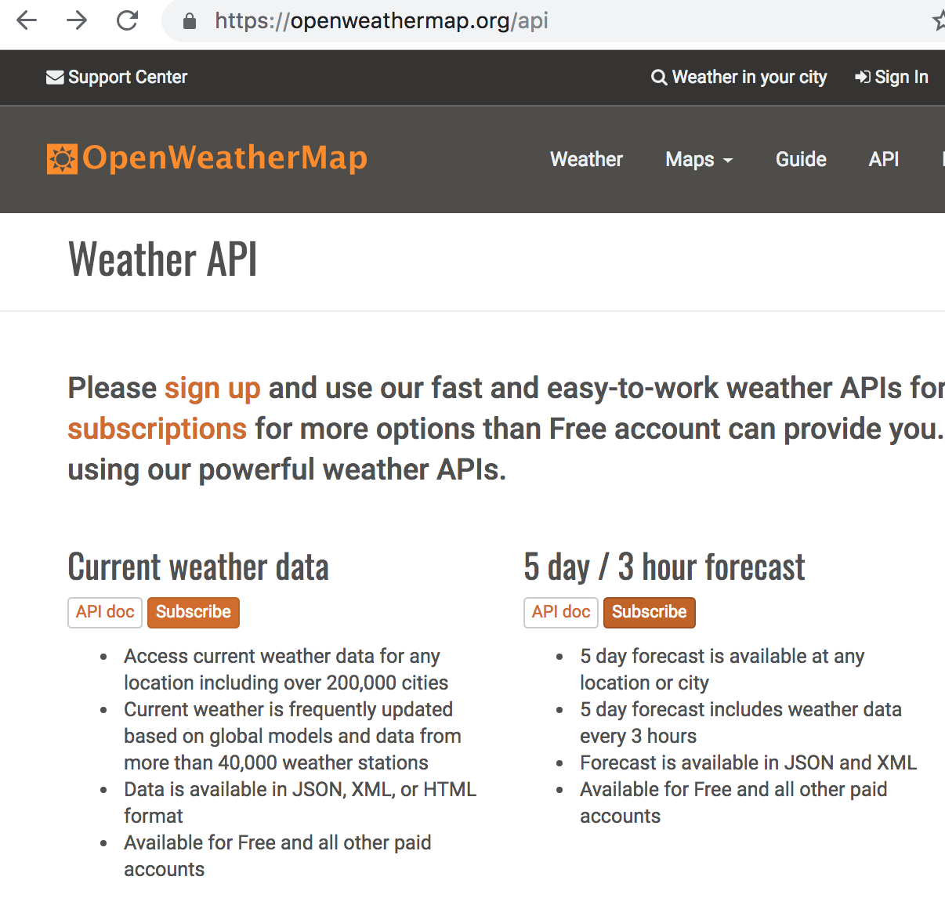
API Keys - Weather
Let's check the weather forecast
https://openweathermap.org/api
Sign up for an account, sign in Subscribe to the 5 day/ 3 hour forecast
Also open the API docs for this service

Slide 31
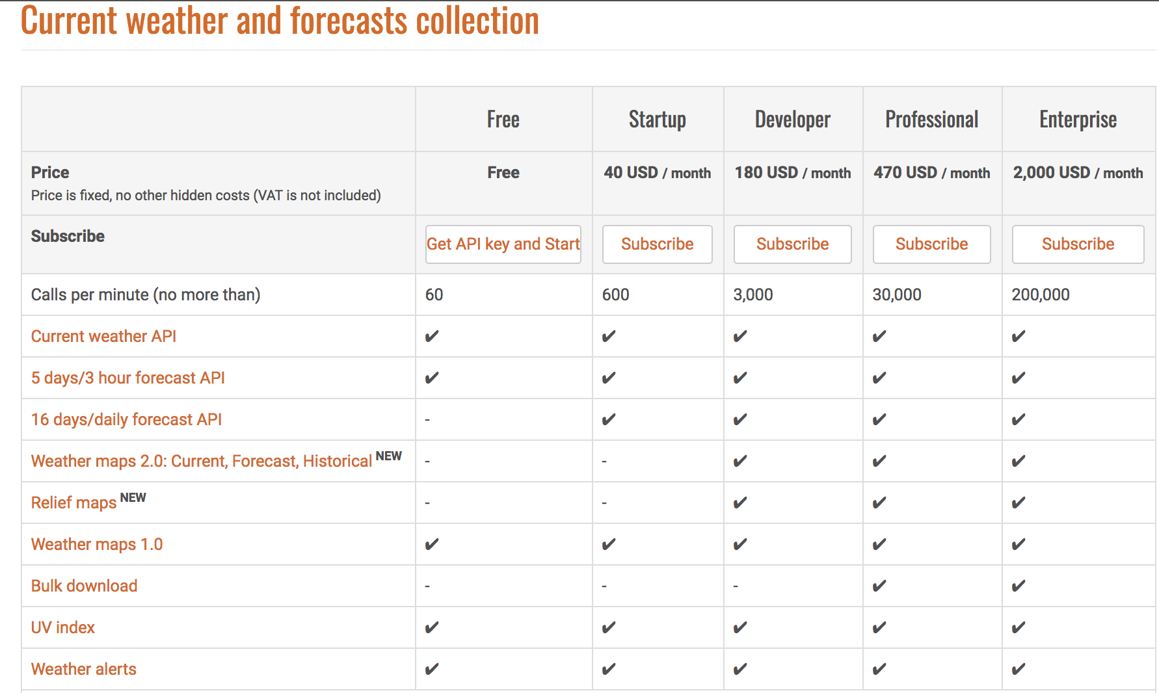
Subscribe to free service
Click Get API key and start
Notice the different levels of service have different pricing
Should take you to keys page, if not
https://home.openweathermap.org/api_keys

Slide 32
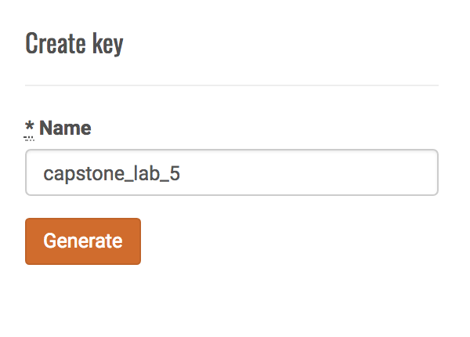
Enter a name for your key and click generate
Developers may need many keys for different services
Copy your key, or leave this page open
This key is like a password to access the API on your behalf, so you should keep it private
You can always check your key in your account

Slide 33
What's the current weather for Minneapolis?
Let's read the docs https://openweathermap.org/forecast5
From the examples, it looks like we need to create a URL in this format for the Paris, France, forecast
But with KEY replaced by your key
The URL includes data as parameters, key=value pairs
http://api.openweathermap.org/data/2.5/weather?q=paris,fr&appid=KEY
Path to resource
parameters
Follow a ?
name=value pairs
separated by &

Slide 34
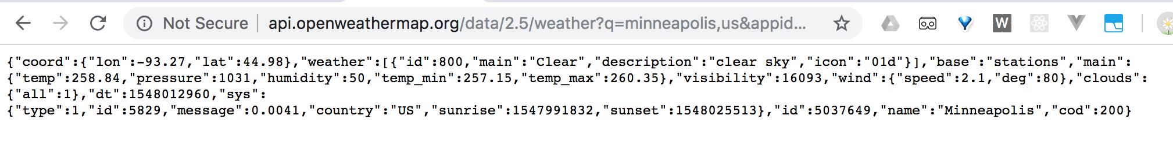
APIs - Parameters
Create a URL like the one on the previous page
Replace paris,fr with minneapolis,us
Replace KEY with your own key
Try this URL in your browser. What response do you get?
Try pasting the response into JSON Formatter to help see the structure

Slide 35
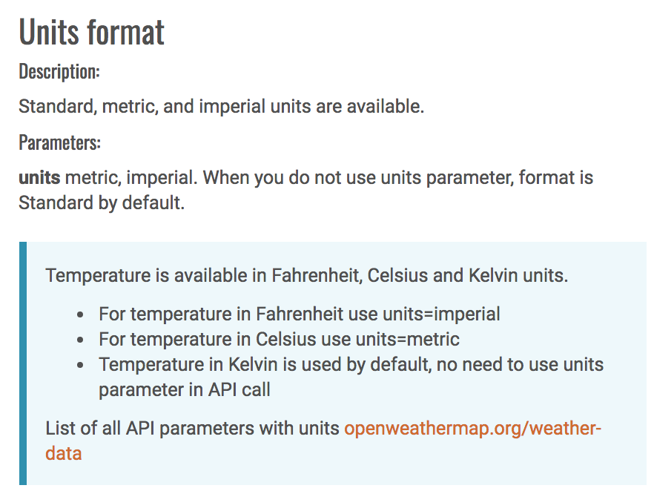
Documentation
Look at the temperatures - looks odd? By default, the temperatures are in standard temperature units called Kelvin
Should we convert in code?
Let's check the documentation first
If we add another parameter we can set the units to something more readable
Since we are in the US, let's use imperial or US measurements for Fahrenheit (although if you prefer Celsius, use metric)
So your URL will look like this
http://api.openweathermap.org/data/2.5/weather?q=paris,fr&units=imperial&appid=KEY
add units=imperial or units=metric parameter

Slide 36
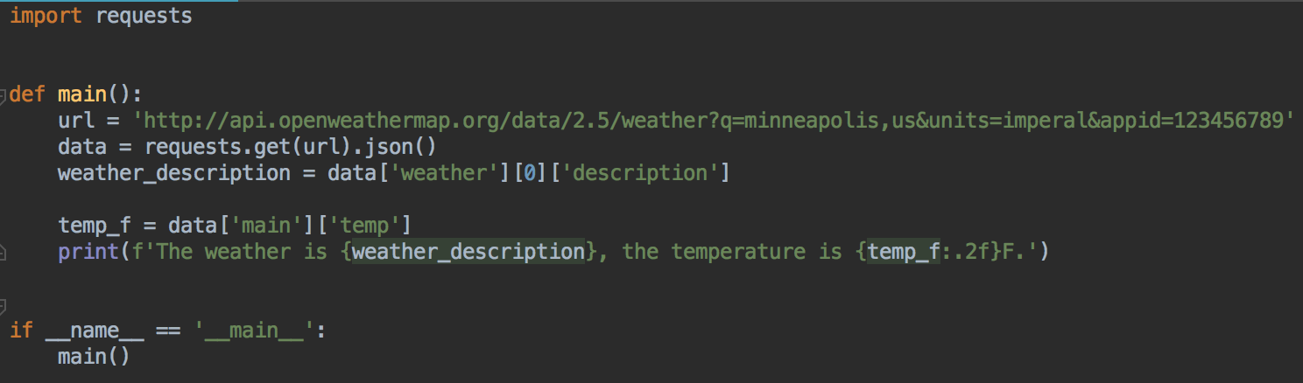
Use in program
Replace the 123456789 key with your own
If you used metric, then adjust the print statement to print C instead of F

Slide 37
Key Management
It's not a good idea to write your key in code
How can you keep the key secret and push code to GitHub?
Keys can change - you might have a different key for development and for the real product
If the key is compromised (e.g. it accidentally got published to GitHub) it needs to be deleted and a new key re-issued
One solution: save the key in an environment variable

Slide 38
Environment Variables
A variable that your computer stores
Programs can read environment variables
Common solution to private data needed by programs, that should not be part of the codebase
Also used to store database access credentials
And for high-level development settings
Run the program in development or production mode?
What port should the web server run on?
Remember how to set an environment variable on your computer
You'll need to set environment variables several more times in this class

Slide 39
Temporarily Setting an Environment Variable
Temporarily, in the terminal/command prompt you will run your Python code from
Replace 123456789 with your actual key
When you close this terminal/command prompt, the environment variable will be forgotten
MAC
export WEATHER_KEY=123456789
PC
set WEATHER_KEY=123456789
To verify on Mac
- Print WEATHER_KEY
echo $WEATHER_KEY
- Print all environment variables
env
To verify on PC
- Print WEATHER_KEY
echo %WEATHER_KEY%
- Print all environment variables
set

Slide 40
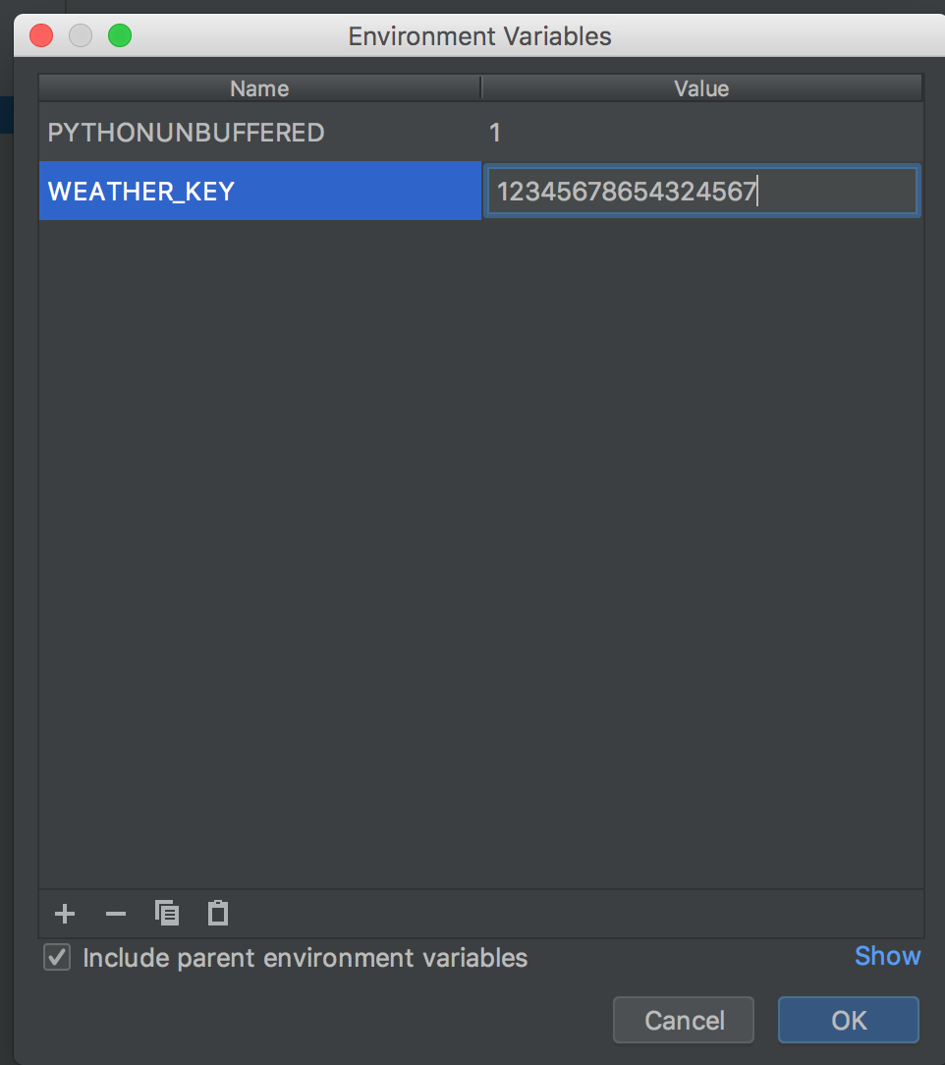
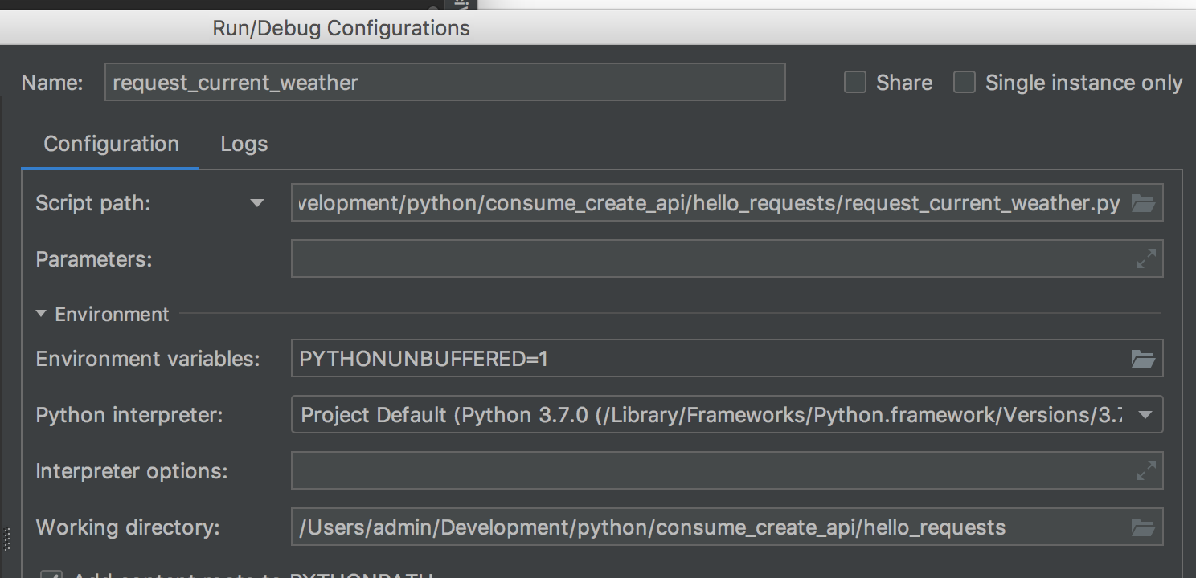
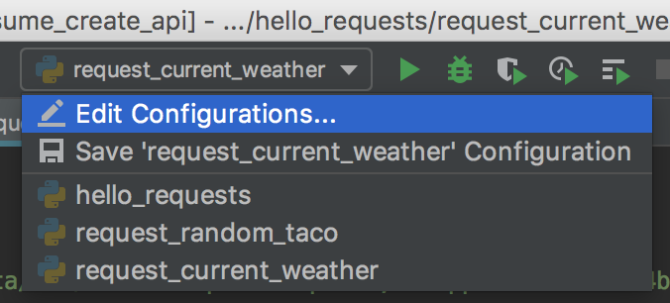
Environment variables, PyCharm
Run your code that expects to have an environment variable
Click on the name of the file you are running, menu bar, top right
Select Edit Configurations, Environment Variables, Add
Environment variable will be set when you run this
code by clicking the play button for the configuration

Slide 41
Environment Variables, Set Permanently (until you change it)
Mac: edit your ~/.bash_profile file and add the same command from the previous slide. Start a new terminal or run source ~/.bash_profile to apply the new variable
PC: in your advanced computer systems, look for the environment variables setting https://www.computerhope.com/issues/ch000549.htm#windows8
Lab PCs don't have permission to set environment variables
Set temporarily, or in PyCharm

Slide 42
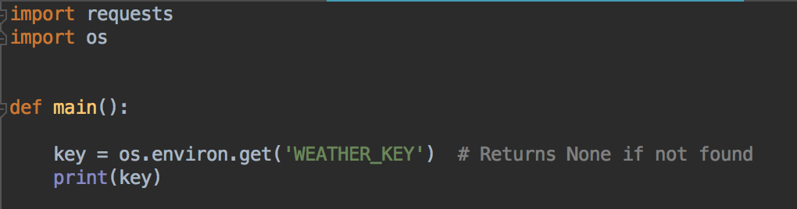
Reading environment variable
Set an environment variable called WEATHER_KEY
In your code, import os, and read environment variable
Temporarily print it out, to verify it was read correctly
Add this to the start of your main method, rest of your program follows

Slide 43
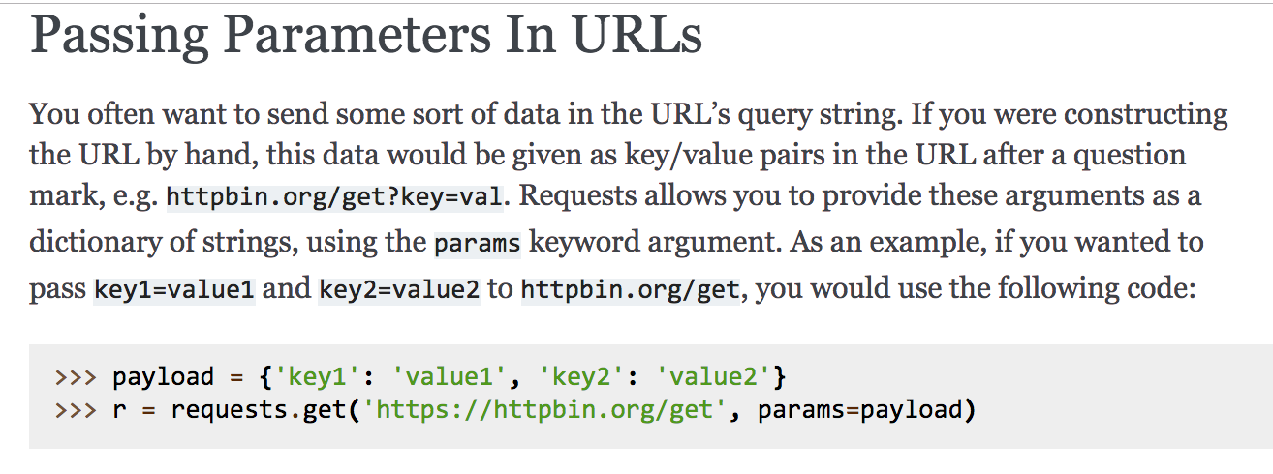
Query Parameters
Building the URL string from other strings is error prone
And we might need to change the city and country, so it would be useful to have more control over what query parameters are used
Requests is helpful - from their documentation:

Slide 44
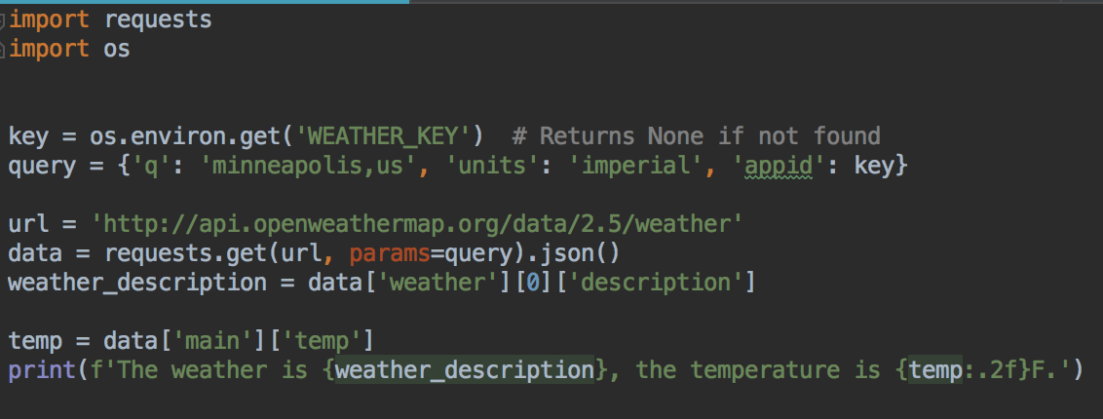
Query Parameters
Modify your main function
Modify the URL - just need the base now
Query parameters in a dictionary
More readable
Your turn: check if the key is None after reading it. If it is None, end the program, print an error message, don't try to make the request

Slide 45
Your Turn
Ask the user what city, and country (as a two-letter country code) they would like the weather for
Use that instead of the hard-coded 'minneapolis,us'
Run and test
List of country codes https://en.wikipedia.org/wiki/List_of_ISO_3166_country_codes

Slide 46
Error Handling
Anyone's code crashed yet?
Why?
What else might go wrong?
You'll add some error handling in lab
Example with some error handling in the code repo for this week

Slide 47
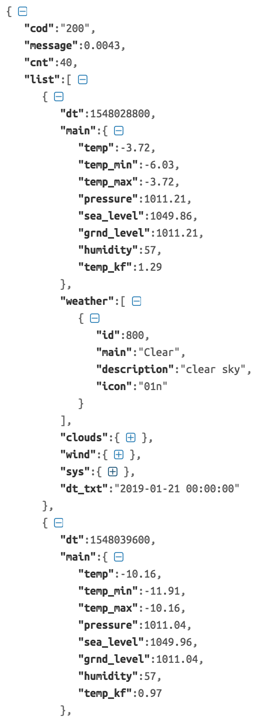
Other requests
Can request a forecast
Returns the five-day forecast in 3-hour increments
Try out this URL
http://api.openweathermap.org/data/2.5/forecast?q=minneapolis,us&units=imperial&appid=KEY
Part of the forecast response
The list attribute is a list, that you can loop over in Python

Slide 48
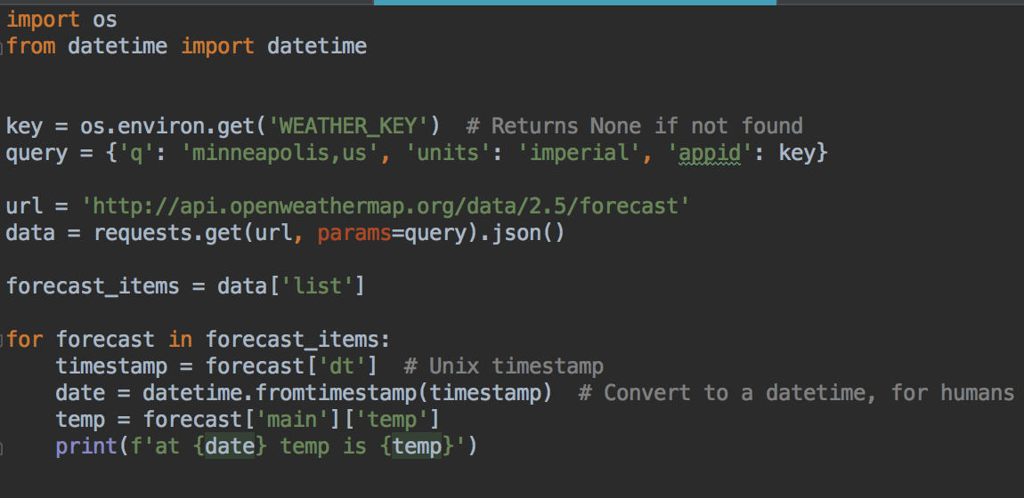
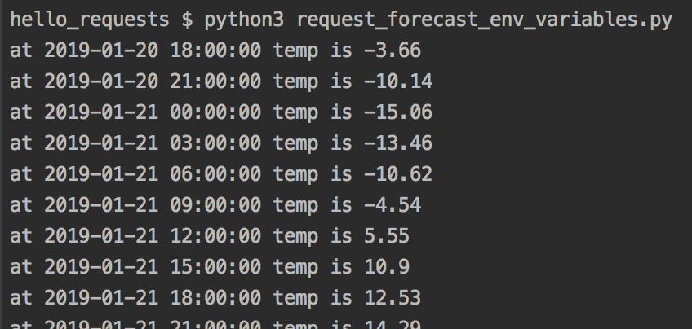
So we could process it like this
There is a dt_txt attribute for every forecast item in the list, but these times are in the UTC timezone. Converting from the timestamp into a datetime will give us a local Minnesota time.
Neither solution is perfect - times and time zones are hard.
See extra materials in D2L on time and timezones.

Slide 49
Other requests - POST, PATCH, DELETE
There are different methods you can use to make a HTTP request
This tells the server if you want to get data, or update data, or you've got a new data item to save....
So far, we've fetched data using a GET request
If you are using a social media app, and you write a new status, your browser will make a POST request to the server to create a new status in your account
If you edit your status, your browser will make a PATCH request to update your status
If you regret everything and want to delete your status, when you click the delete button, your browser will make a DELETE request

Slide 50
Other requests - POST, PATCH, DELETE
Like the GET requests we just made, POST, PATCH and DELETE have a path to a resource,
And can contain data, in the form of key-value pairs
For POST/PATCH/DELETE the data is sent in the body of the request, not as part of the URL
Why? So it can be encrypted and can't be bookmarked

Slide 51
Testing post, patch etc.
Can't just paste in browser URL
Use tools like Curl or Postman
https://curl.haxx.se/
https://www.getpostman.com/

Slide 53
First step in testing: writing code that can be tested
This usually means code in functions, modules
A function should have a focused, specific purpose
The functions input and output should be well defined

Slide 54
Modular code
Modular, loosely coupled code
Focused modules, functions
Minimal dependencies on other code
Good design, and makes testing easier too

Slide 55
Mocking and patching
How do you deal with user input/output?
Random numbers?
Databases: wouldn't it be easier to just provide some example data instead of having to set up an entire database of data? Also, want to avoid test data corrupting real data
API calls?

Slide 56
Examples at
https://github.com/claraj/capstone_testing_2

Slide 57
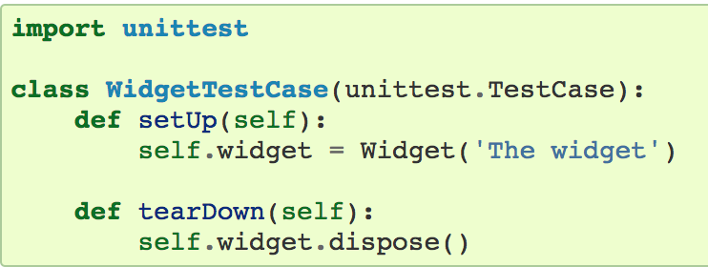
Testing Databases - Fixtures
setUp and tearDown are text fixtures – for setting up the test environment
For example, a setUp fixture could insert example data into the database before of the tests run
Example: test database pre-populated with test data would be useful for testing a search function

Slide 58
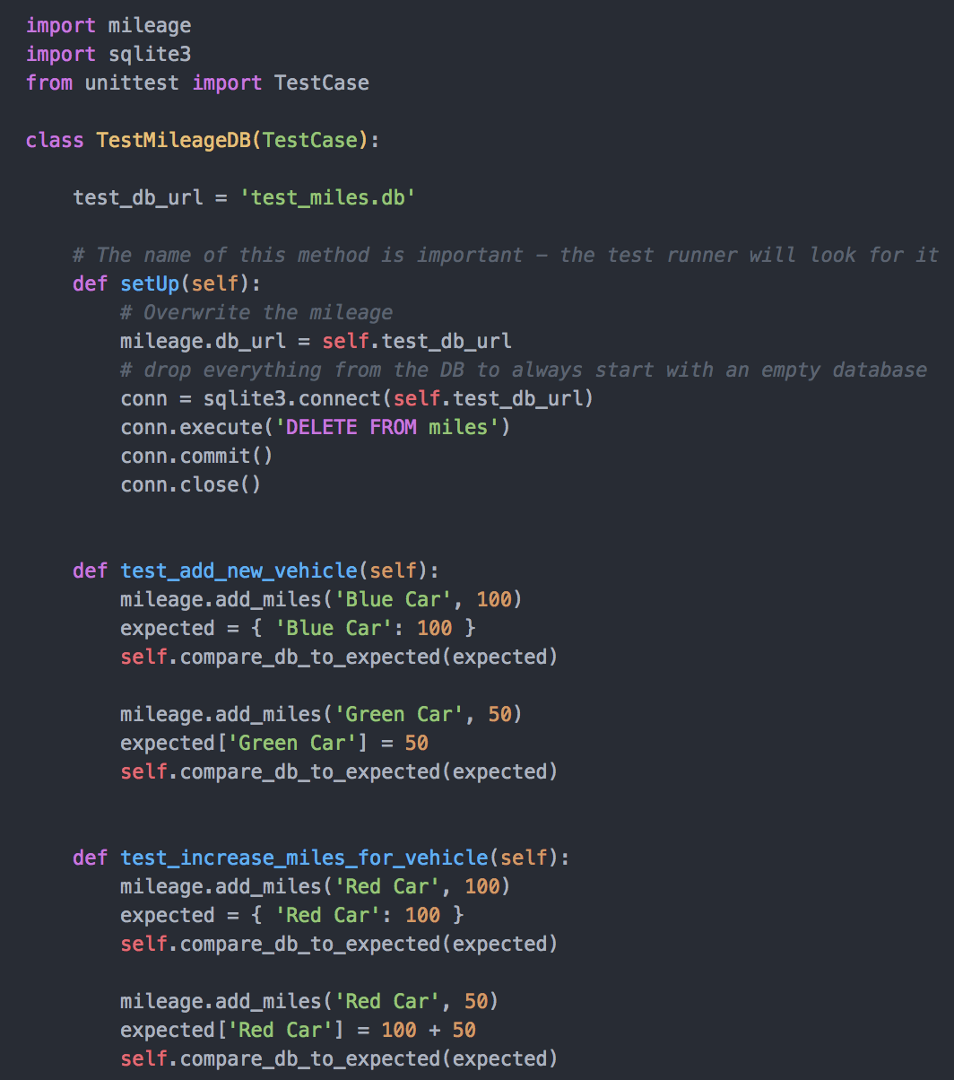
test_milage.py
setUp method is called before each test
Useful for setup, in this example replacing the program's db_url variable with the test database, and removing all data from the database
tearDown method can be used for cleanup, post-test tasks

Slide 59
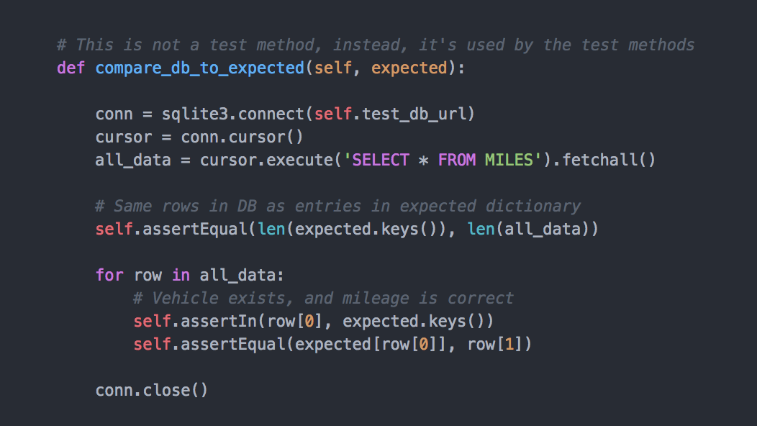
Helper methods in tests
Method names that don't start with test… and are not special names like setUp and tearDown are ignored by the test runner
So, can create helper methods

Slide 60
What if some tests need one type of setup, other tests need different setup?
Create two (or more) TestCase subclasses
Provide different setUp methods, or omit setUp method, as appropriate
import unittest
class TestWithExampleData(unittest.TestCase):
def setUp(self):
# set up DB, insert test data
def test_search_feature(self):
# write test here
class TestWithEmptyDataBase(unittest.TestCase):
def setUp(self):
# set up DB
def test_add_new_data(self):
# write test code

Slide 61
More than one TestCase
Can add many test classes, subclasses of unittest.TestCase
Useful to gather together related tests
Useful to provide different setUp and/or tearDown for sets of tests
The unittest test runner will run all the tests for all the classes in the file

Slide 62
Mocking and Patching
Consider a program that interfaces with an API
Remember API calls can modify, create data
How to test without affecting real data?
Can we substitute a fake API call somehow?

Slide 63
Mocking and Patching
Consider a program that gets user input
How to test without having to type in a response for every test that needs input?
Or in other words, can we force a particular return value from a function like input?

Slide 64
Mocking and Patching
What about printing? How to check what was printed?
Another way to phrase this question is "How to check what the a function like print() was called with?"

Slide 65
Mocking and Patching
Python methods, classes and functions are objects, and can be modified and replaced on the fly
A Python mock can pretend to be an object (with variables, and methods) or a function
Mocking:
Creating a pretend object/function/method to replace one in your program
Can provide example return values, and record how it was used and called
Patching:
The action of replacing a function or object with a Mock object

Slide 66
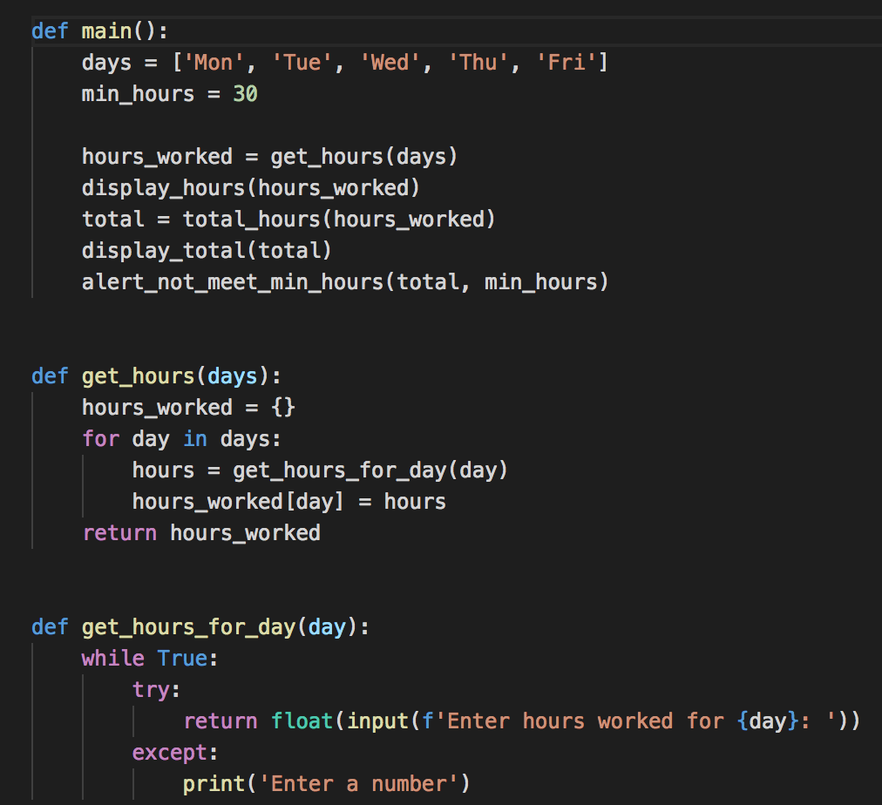
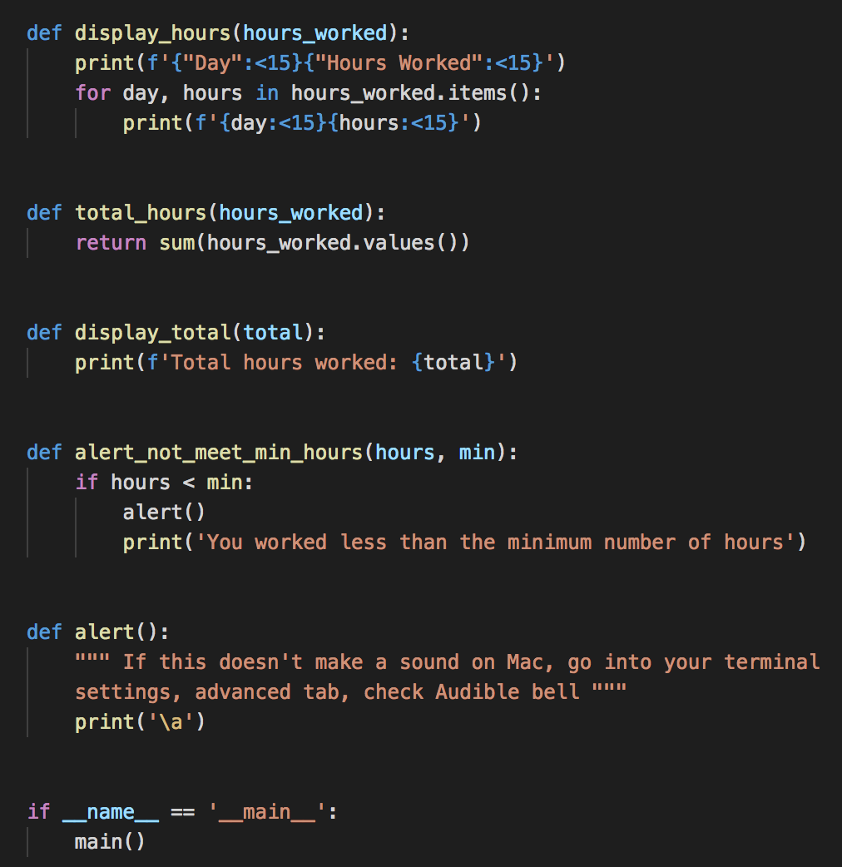
Timesheet program
Full program in example repo

Slide 67
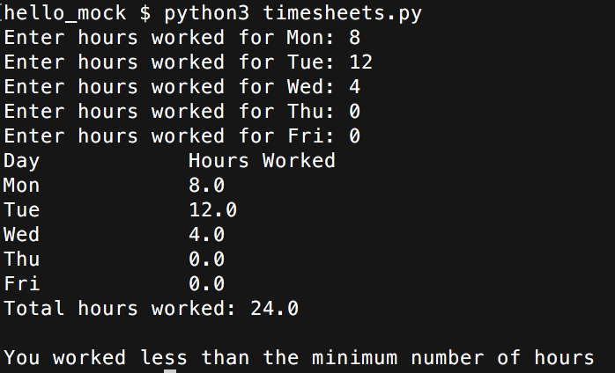
Your Turn
Get the program from https://git.io/fhSxr
Create a new file test_timesheets.py in the same directory
Run and test code
Should beep if total
hours less than 30
beep
Macs: if no beep, in Terminal preferences, advanced tab, check Audible bell

Slide 68
How to test this program?
What functions can we test as they are?
What functions are hard to test?

Slide 69
Mocking and Patching
User input? Replace builtins.input with a mock that returns pre-defined data
Or mock the entire function that uses input(), if we don't need to worry about how the data is obtained
Printing? replace builtins.print with a mock that remembers what it was called with
alert function: replace with a mock that we can check if it was called or not

Slide 70
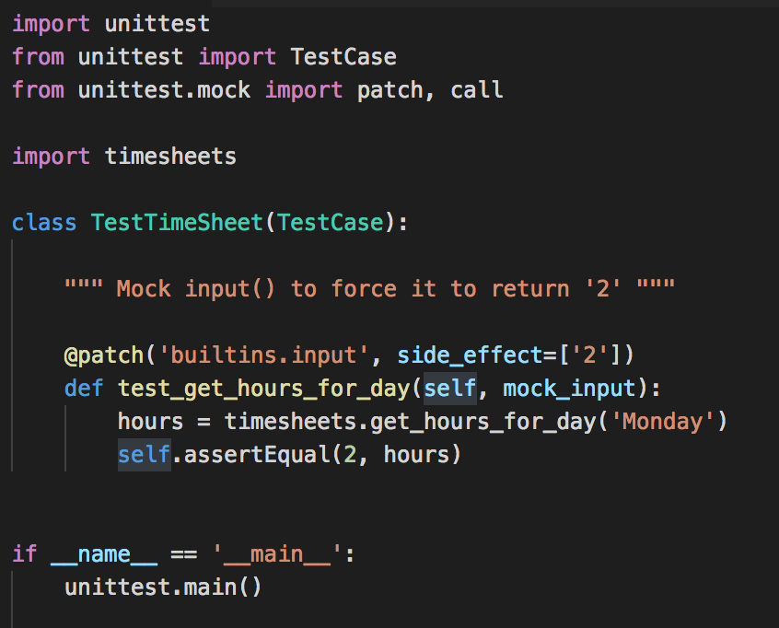
First Test - mock input
Use the mock to provide pre-set return values, the side_effect
@patch decorator, provide mock as argument to test method
put the rest of the tests here

Slide 71
Run test
python test_timesheets.py
Should have one passing test

Slide 72
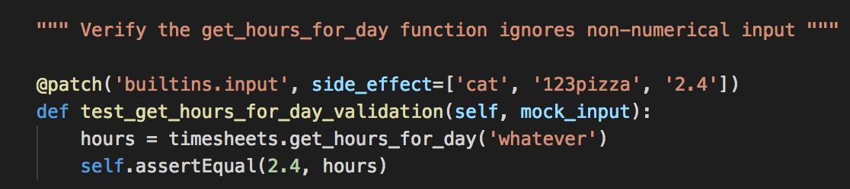
Expecting the mock to be called more than once - provide list of side_effects
Test validation - program should reject non-numerical input
Provide example invalid data, followed by valid
Run your tests - should have two passing

Slide 73
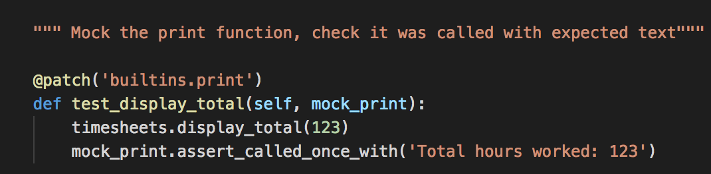
Mocking print
Similar process, @patch decorator
print() doesn't return anything so don't need side_effect
Do need to provide the mock as an argument to the test method
Run your tests - should have three passing

Slide 74
Side effects, return value
side_effect: an iterable object (list, tuple, string…) Every time the function is called, the mock will return one item from the side_effect iterable, one by one
Error (test fail) if you call the function more times than the length of the side_effect iterable
side_effects can be used in other ways - a function can provide the return value, it can be based on the argument when the Mock function is called; side_effect can be used to throw exceptions… see documentation
To always have the same return value from the Mock every time it is called, set the return_value

Slide 75
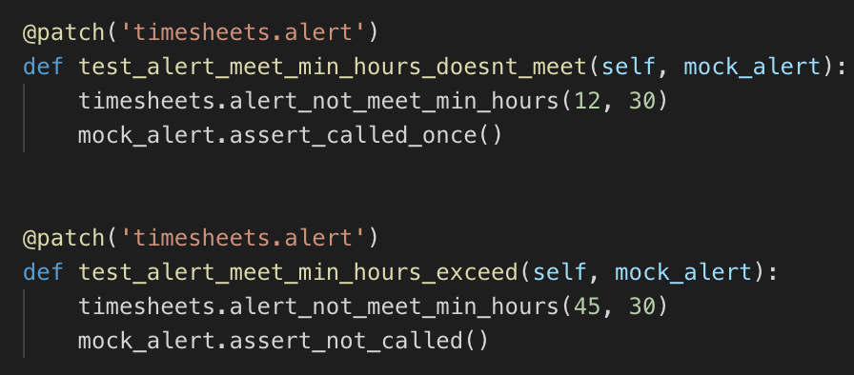
Mocking your own functions
Anyone want to listen for beeps all day?
Better approach: mock the alert function and assert it was called or not called, as appropriate

Slide 76
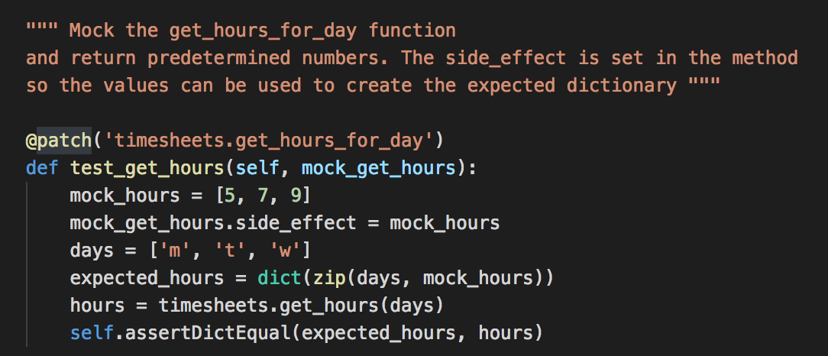
Mocking your functions
Test for the get_hours() function, that gets all the hours for all the days
For this function, set the side_effect in the test method, since it's useful for creating the expected dictionary
Question: why don't we need to mock input here?

Slide 77
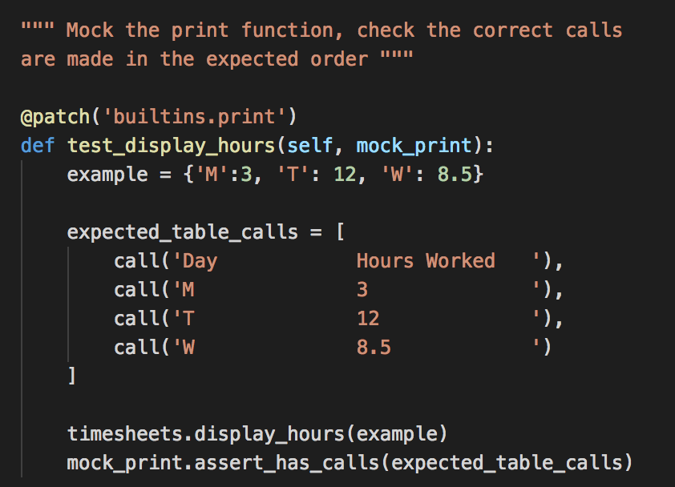
Checking what functions are called with: call objects
Test for displaying the table
Should have 7 passing tests now

Slide 78
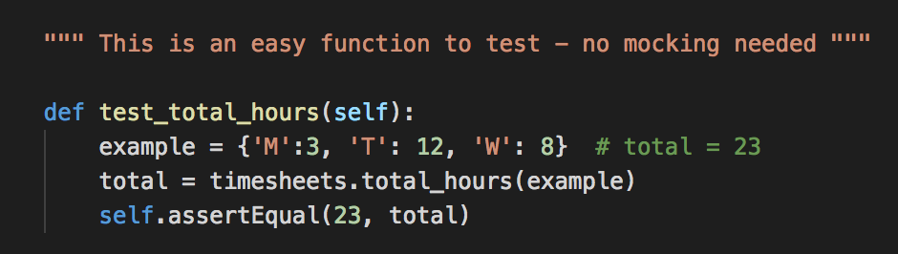
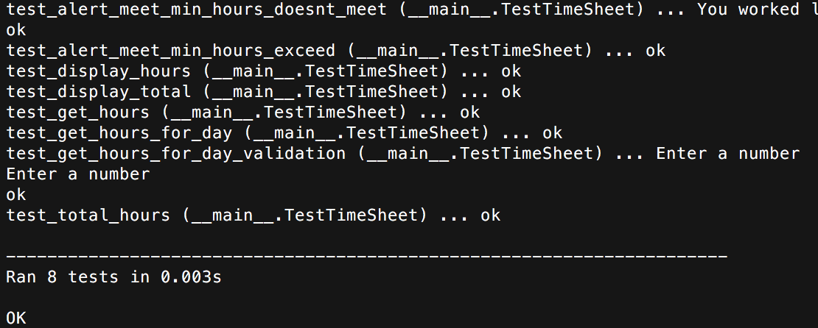
What's left?
One more function - this one is easy
Should have eight
passing tests

Slide 79
Mocking and patching
Avoid if you can
Write functions that don't depend on things that need to be patched for tests
Keep your functions focused, with input through parameters and output from return values

Slide 80
Mocking and patching
Python's documentation https://docs.python.org/3/library/unittest.mock-examples.html
Patching built-in functions: http://fgimian.github.io/blog/2014/04/10/using-the-python-mock-library-to-fake-regular-functions-during-tests/
There's several ways of patching: http://treyhunner.com/2014/10/the-many-flavors-of-mock-dot-patch/

Slide 81
Testing APIs, various approaches
Testing strategy | Pros | Cons
Calling the actual API | Most realistic | Slow Cost Could affect production data
Mock the API call method to return sample data | Control over exactly what is returned for a given call Fast Does not modify production data | Need to ensure the expected response is accurately replicated
Use a mock API server E.g. json-server https://github.com/typicode/json-server | Fast Don't need to modify code, only point to mock API URL Can save data from POST and PATCH requests Does not modify production data | Need to set up a mock API server with good test data

Slide 82
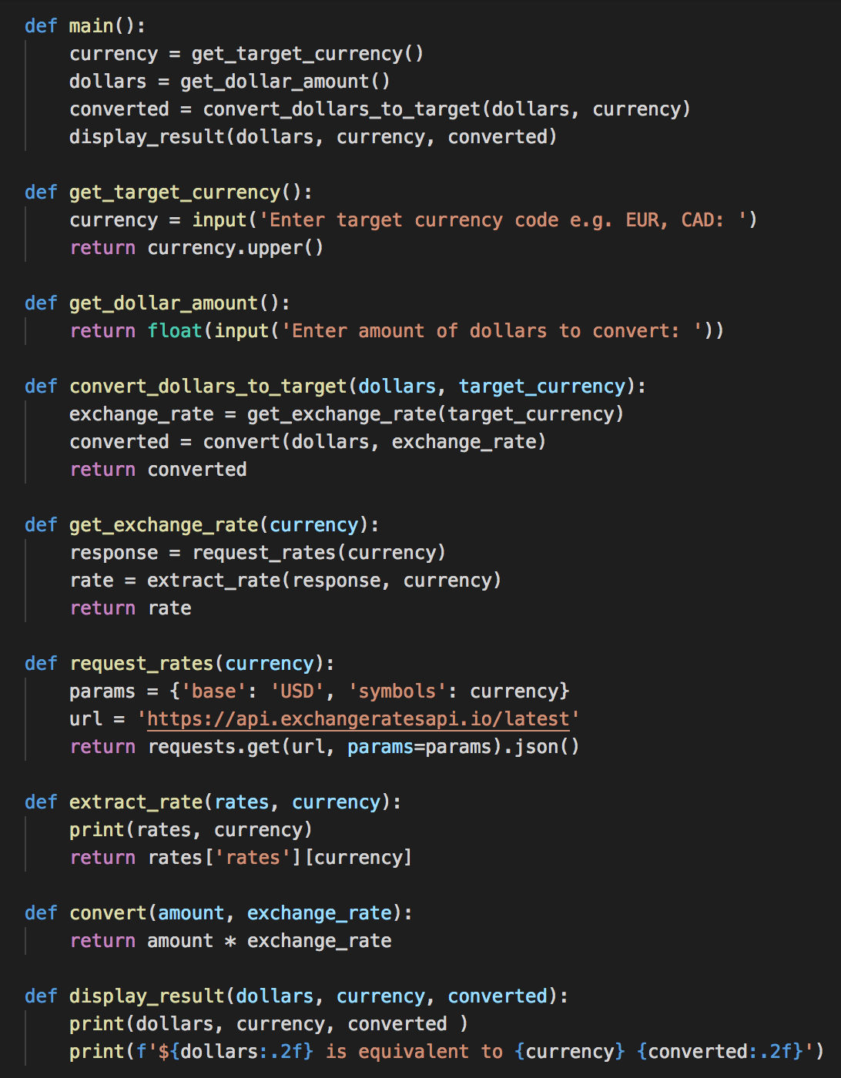
Exchange Rate Calculator
API call in one function
Extract data from response in another function
How to test?
Which of these functions can be tested without mocks?

Slide 83
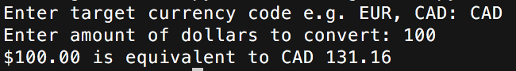
Exchange Rate Calculator
Get code from https://git.io/fhSpx
Run and test
Uses data from https://exchangeratesapi.io/
Note error handling is omitted for clarity

Slide 84
Test the convert_dollars_to_target function
Create test file test_exchange_rates.py
Mock the minimum possible
The API call is in the request_rates function
This function doesn't do any processing of the response, just converts it to JSON and returns
So can mock request_rates and the test can still check other aspects of code

Slide 85
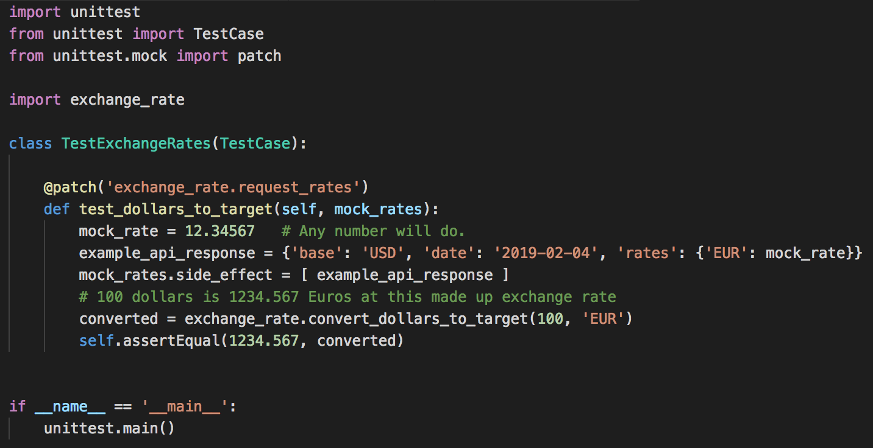
test_exchange_rates.py
Run test - does it pass?

Slide 86
Lab in D2L

